Slide 1

Wigner Description in Quantum
Optics and its Application in Two
Mode Entanglement
Summer Internship Presentation (PH48201)
[Autumn 2024]
By
Abhinaba Pahari
Roll No : 23PH40001
Supervisor : Dr. Tamoghna Das
Department of Physics, IIT Kharagpur
KHARAGPUR - 721302, KHARAGPUR, INDIA

Slide 2
Introduction
Wigner description is used to describe Continuous Variable Systems (Different Quantum Optical States e.g. Fock State, Coherent State etc.) in Phase Space.
Continuous Variable systems are a key tool for quantum information protocols and their practical applications.
Entanglement of two states refer to a finite correlation betweeen them without being separable.
Various States in Quantum Optics
Wigner Description of the States in Phase Space
Two Mode Squeezed State
EPR State and Entanglement
Continuous Variable Systems

Slide 3
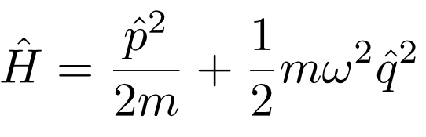
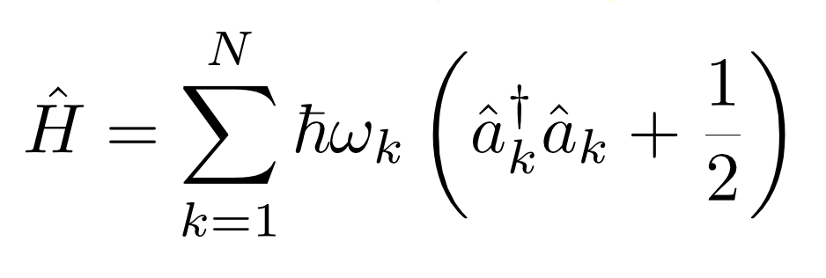
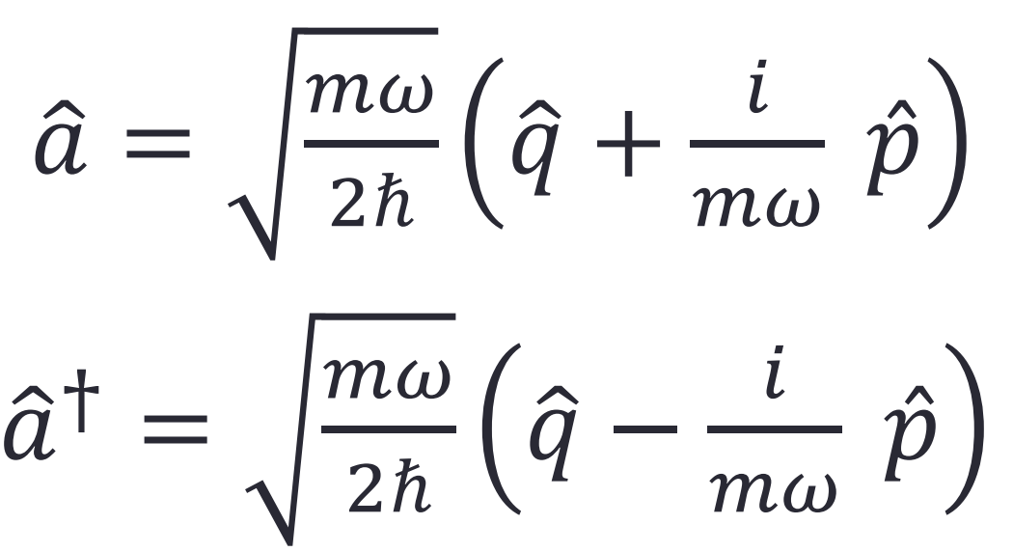
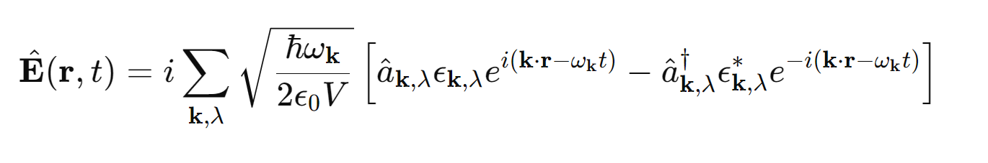
Quantum States in Optics
Electromagnetic Field → Different modes → Each mode associated with Harmonic Oscillator
(Canonical Conjugate Operators) (Bosonic Creation and annihilation Operators)
Relations between Operators and Field Operators :

Slide 4
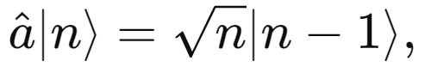
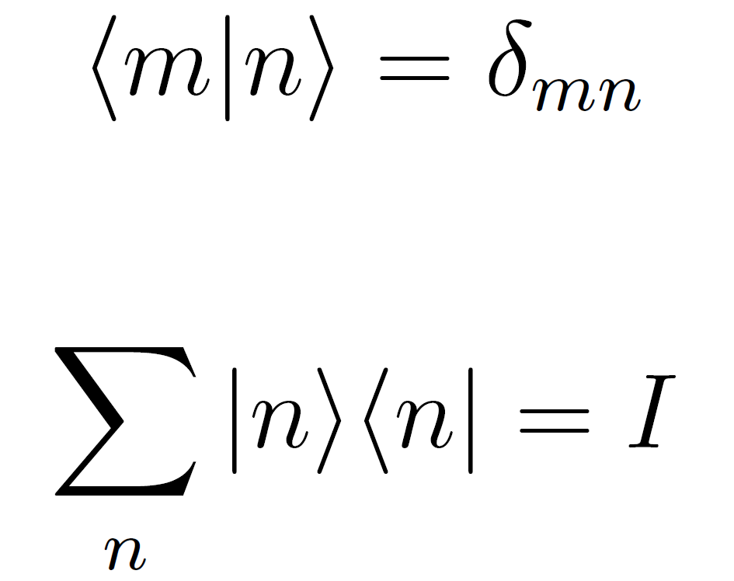
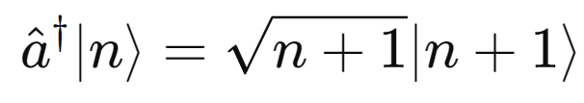
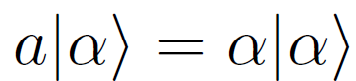
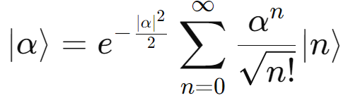
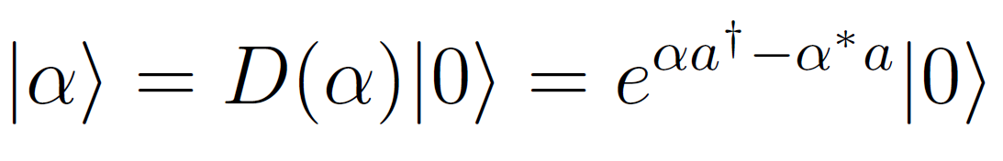
Quantum States in Optics
Fock State :
The single mode states which are eigenstates of the number operator as well as Hamiltonian.
Coherent State :
The single mode states that represents a certain electromagnetic state with certain phase. These are generated by displacement operator on vaccum. These are eigenstates of annihilation operator.

Slide 5
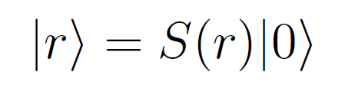
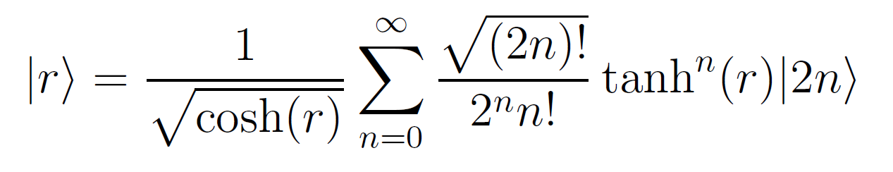
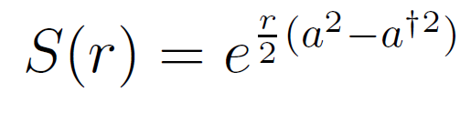
Quantum States in Optics
Squeezed State : The squeezed vacuum state |r⟩ is obtained by applying the squeezing operator S(r) to the vacuum state |0⟩:
Photon added Coherent State : The Photon added coherent state |α⟩ is obtained by applying the creation operator followed by displacement operator D(α) to the vacuum state |0⟩:
Photon added Squeezed State : Single Photon added squeezed vacuum state |r⟩ is obtained by applying the creation operator followed by the squeezing operator S(r) to the vacuum state |0⟩:

Slide 6
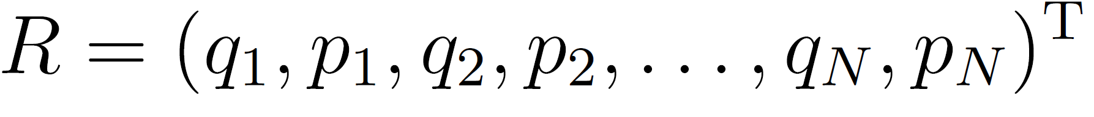
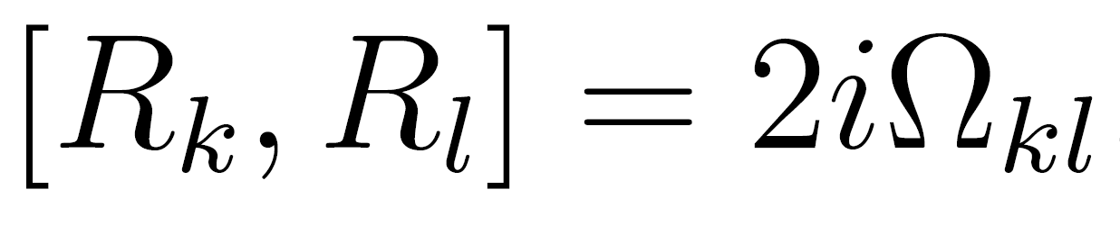
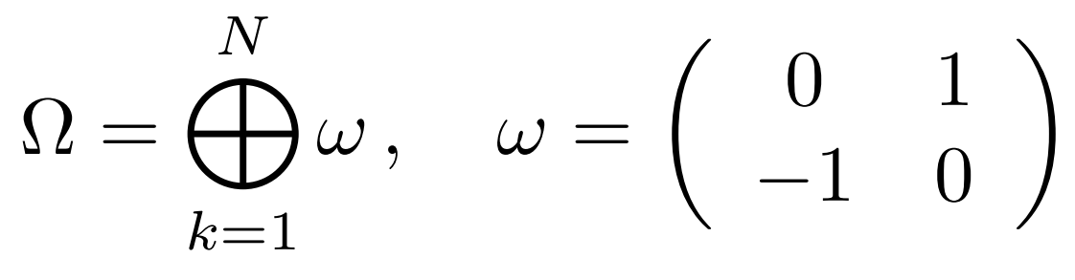
Continuous Variable Systems
Generalization of the quantum states to arbitrarily large number of particles or modes leads to continuous variable systems.
Systems in which the relevant degrees of freedom are continuous variables. With respect to those degrees of freedom, the quantum states of continuous variable systems live in an infinite-dimensional Hilbert space
Generalized Bosonic Commutation Relation
Possible applications of CV systems in quantum information and communication tasks are gaining increasing interest and attention.

Slide 7
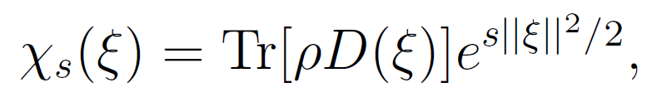
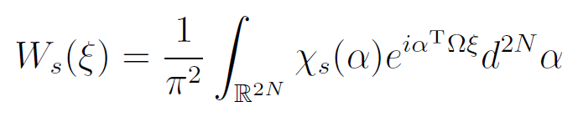
Phase Space Description
Phase-space approach employs a probability distribution over phase space to describe the quantum state.
Instead of a wave function, state vector, or density matrix, we use a quasi-probability distribution f(x, p) that describes how the state is distributed in phase space.
Distribution defined by s ordered Characteristic Function.
s = 1 : Husimi Q function
s = 0 : Wigner Function
s = -1 : P representation
Quasi Probability Distribution
(Quasi because it can be negative or zero)

Slide 8
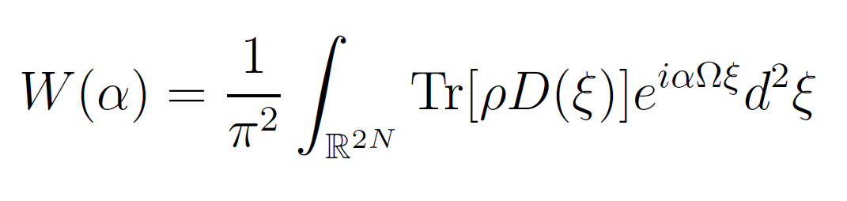
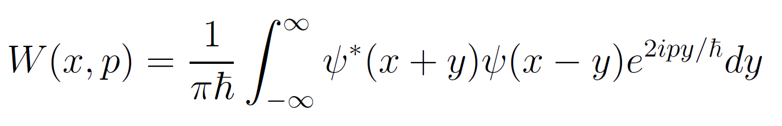
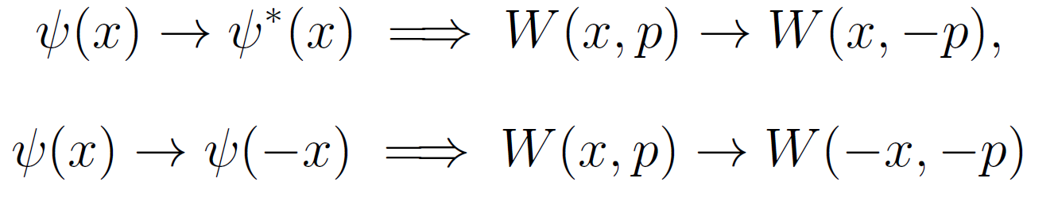
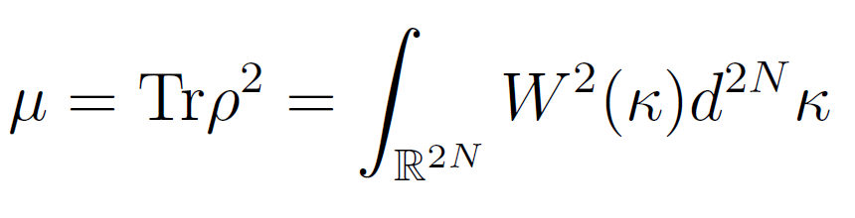
Wigner Distribution
Phase-space approach employs a probability distribution over phase space to describe the quantum state.
For single mode pure state,
Properties :
W(x,p) obeys reflection symmetries.
Negativity of Wigner function depicts non classicality of quantum states.
Purity of a state is given in terms of Wigner
function by

Slide 9
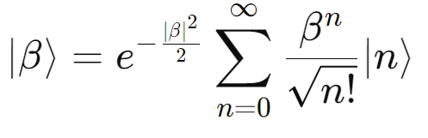
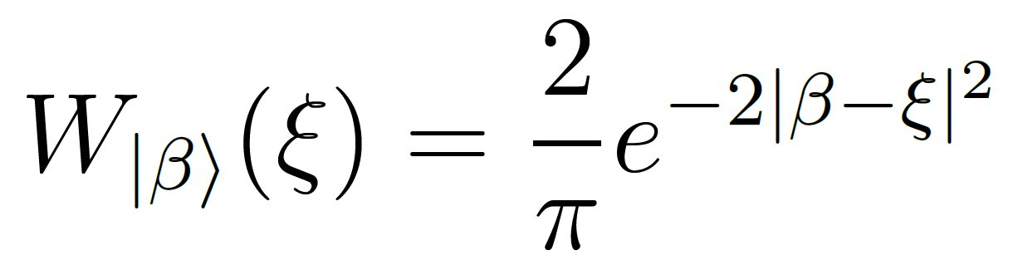
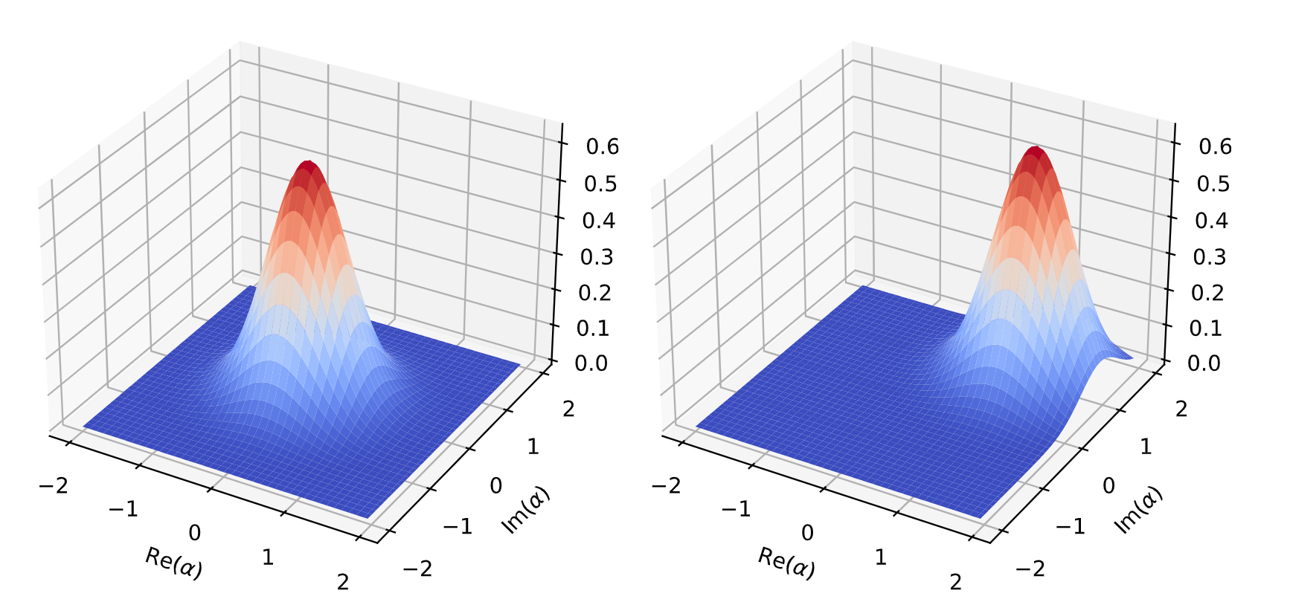
Coherent State
FIG : Wigner Function of two coherent states : |0⟩ on left and |1 + i⟩ on right.

Slide 10
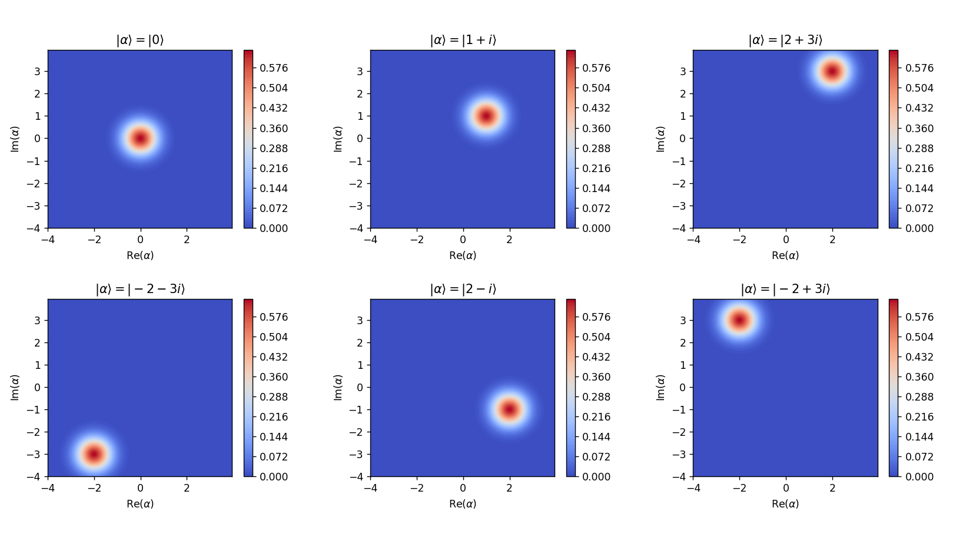
Coherent State
FIG : Density plot of Wigner distribution of few coherent states

Slide 11
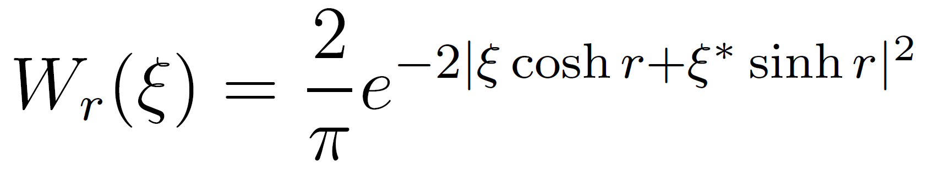
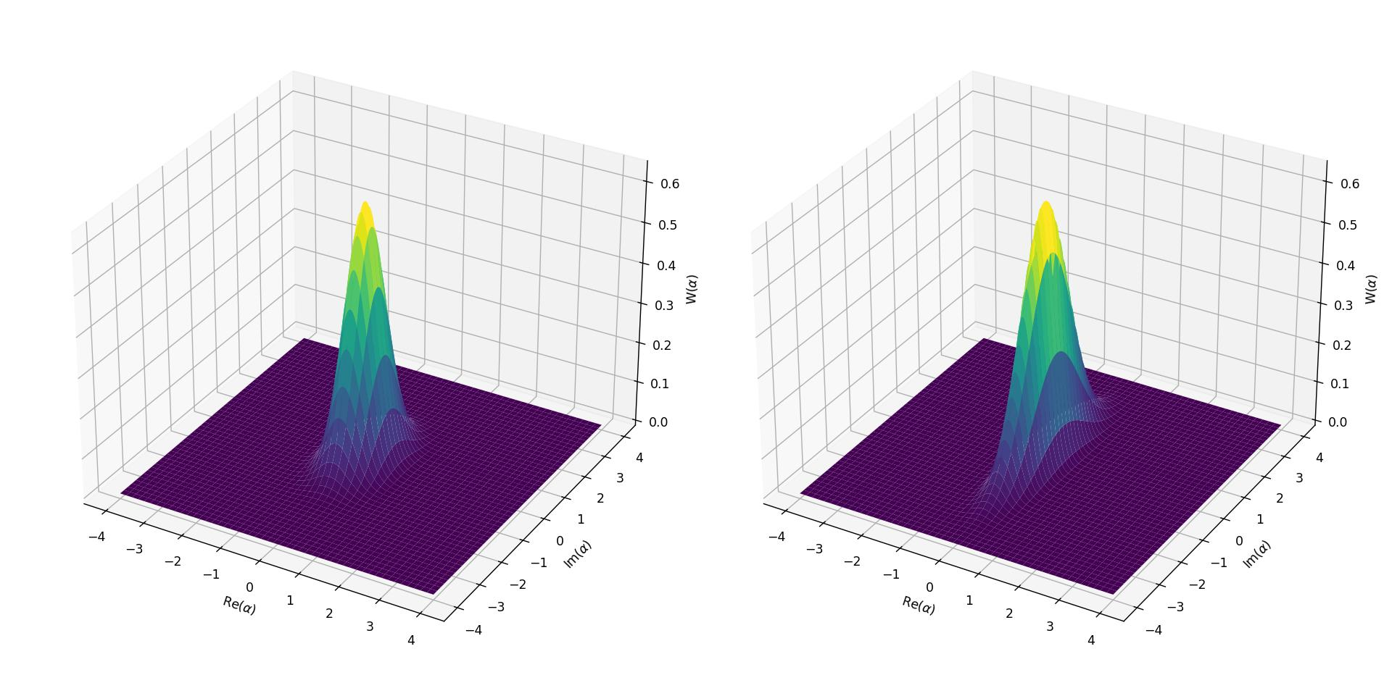
Squeezed State
FIG : Wigner distribution of Two single mode squeezed state : r= 0.3 (on left) and r=0.7 (on right).

Slide 12
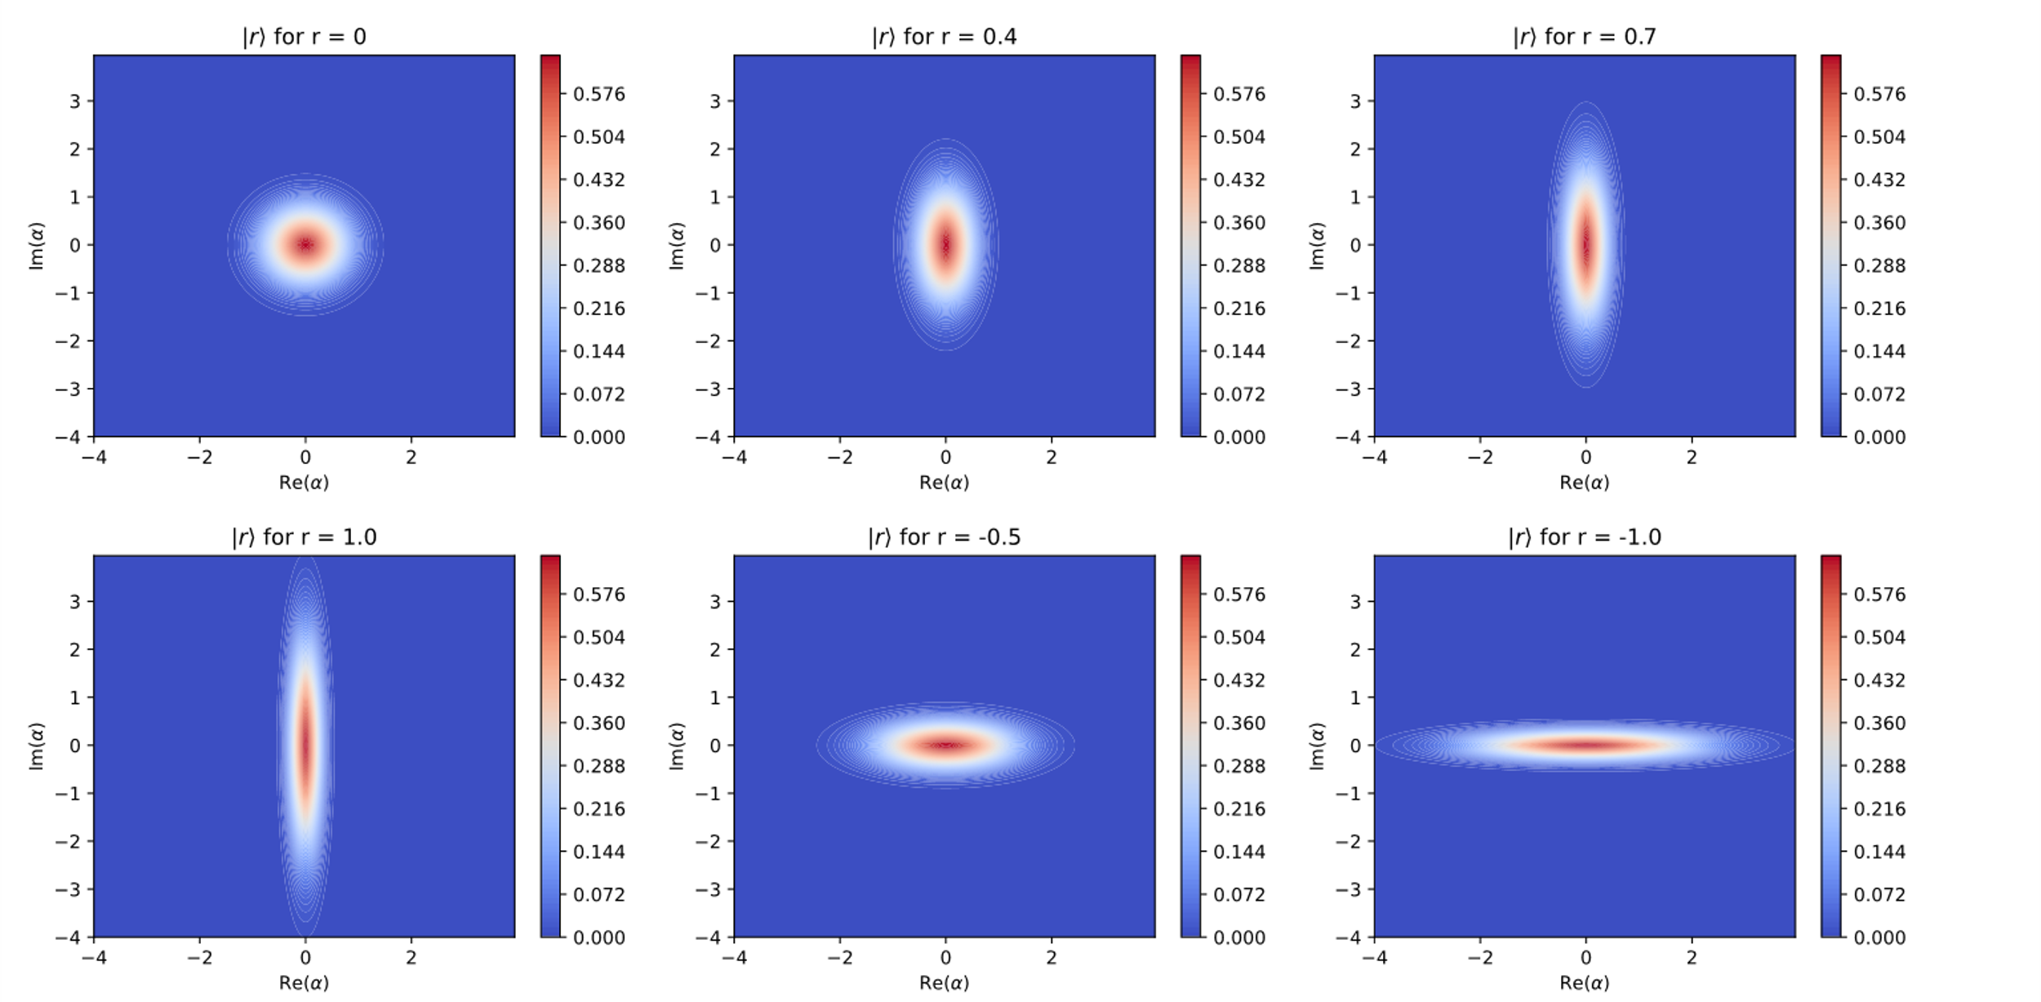
Squeezed State
FIG : Wigner distribution of a few squeezed states centered at origin with different squeezing factor.

Slide 13
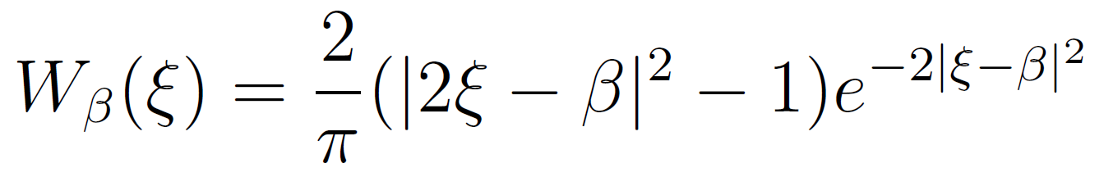
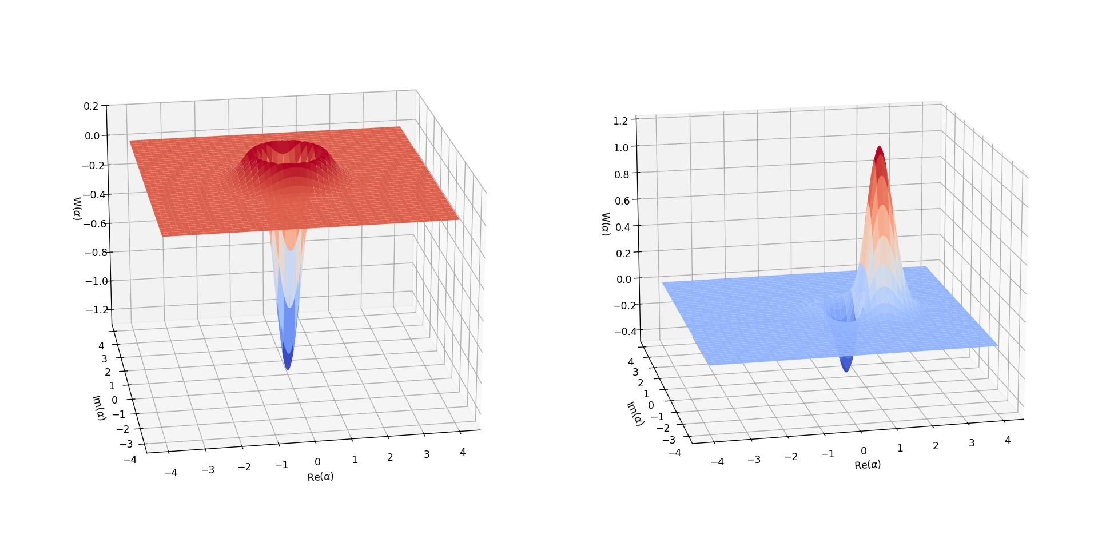
Photon added Coherent state
FIG : Single Photon added Coherent State for |β⟩ = |0⟩ (0n left) and |β⟩ = |1+i0⟩ (On right).

Slide 14
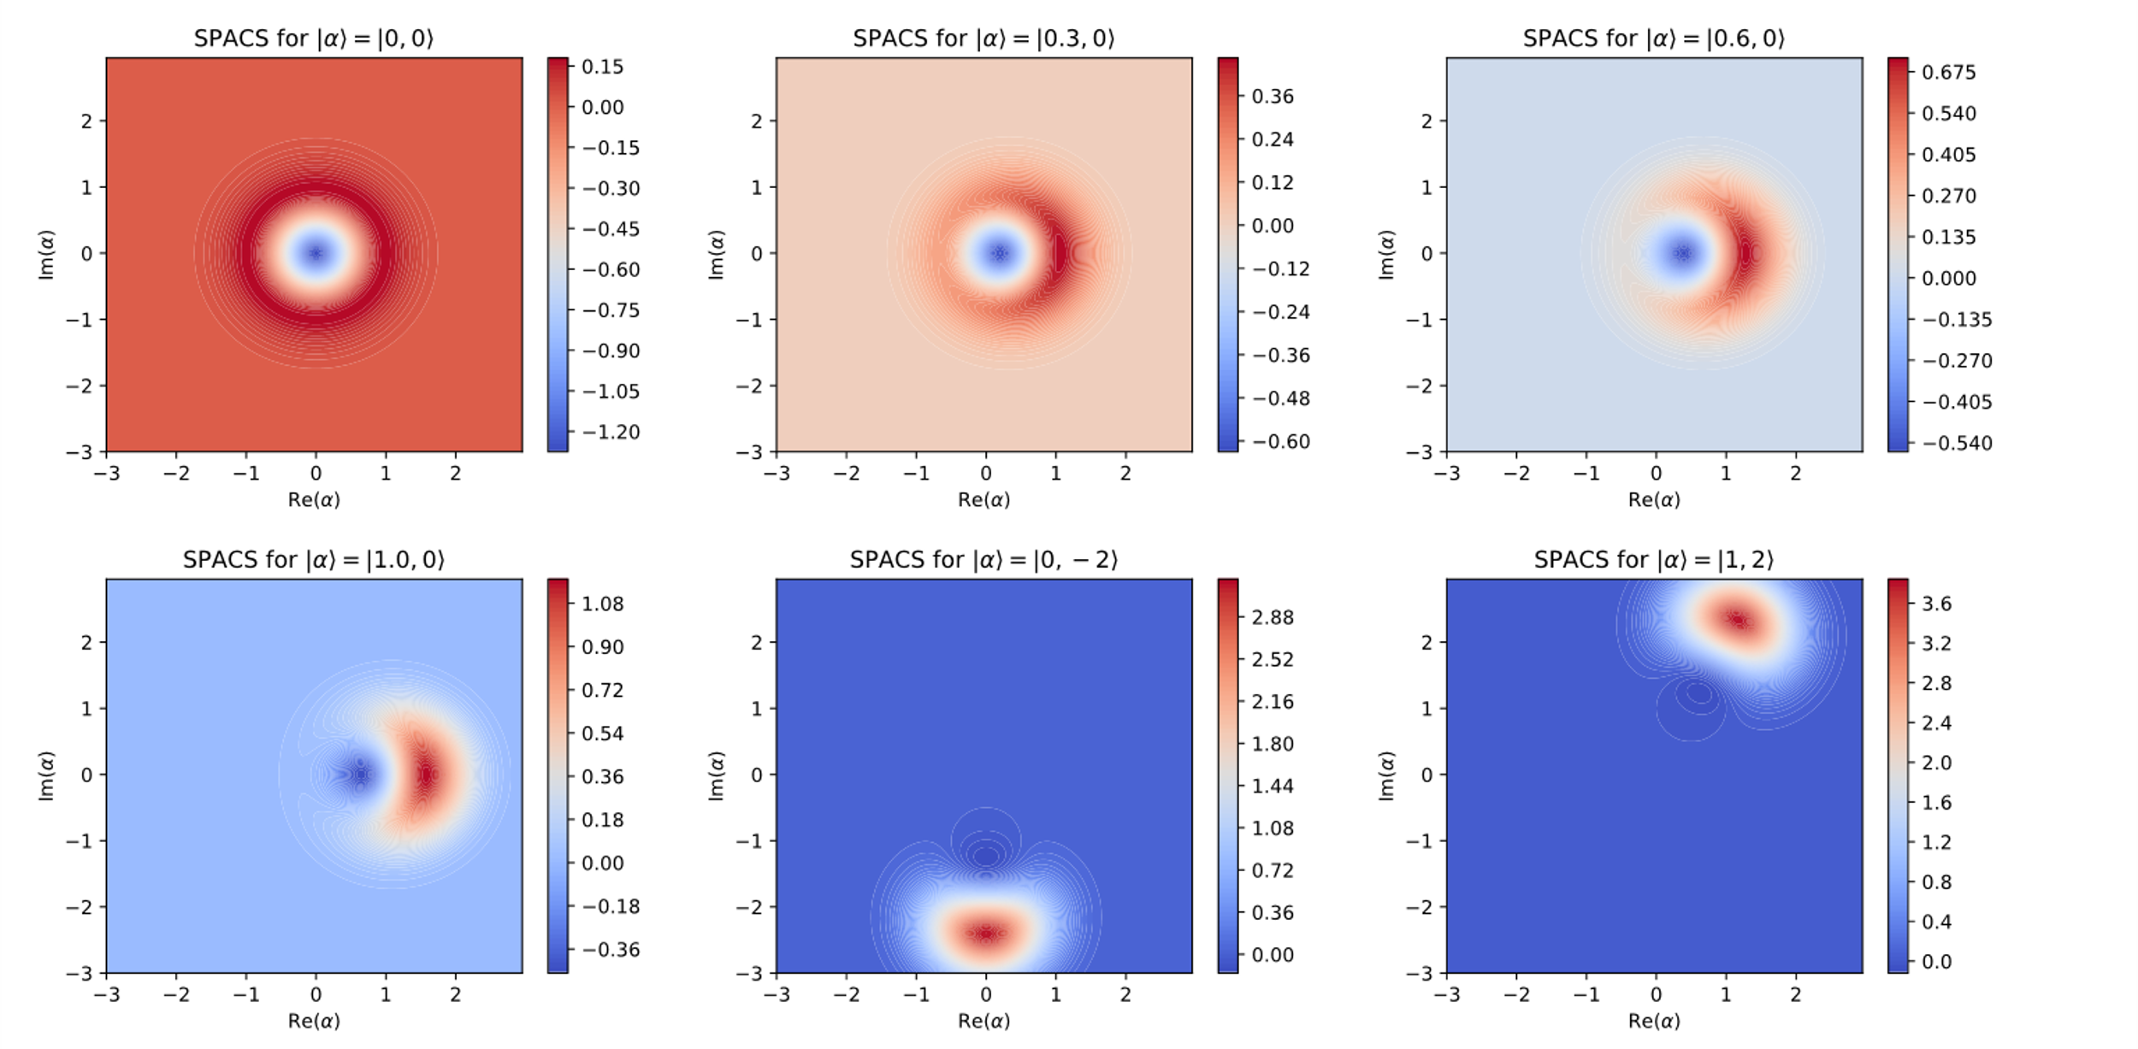
Photon added Coherent state
FIG : Density Plot of Single Photon added Coherent States for different |α⟩

Slide 15
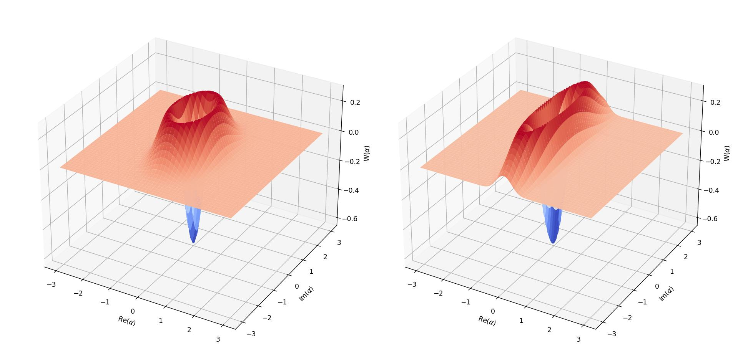
Photon added Squeezed State
FIG : Single Photon added Squeezed State for r = 0.3 (0n left) and r = 0.8 (On right)

Slide 16
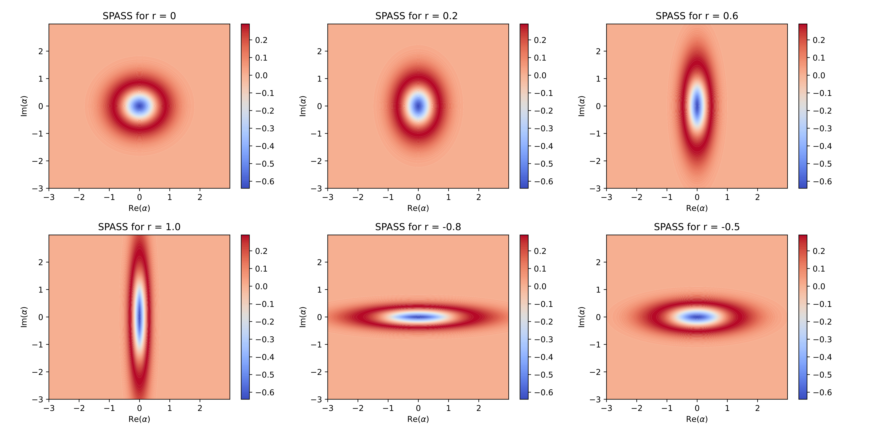
Photon added Squeezed State
FIG : Density plot of Single Photon added Squeezed States for different r.

Slide 17
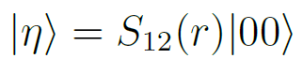
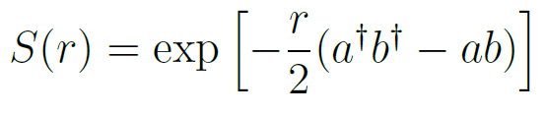
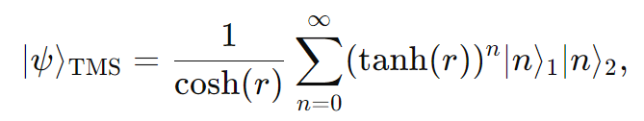
Two Mode Squeezed State
Two-mode squeezed state exhibits correlations between two distinct bosonic modes due to squeezing.
It is a key concept in quantum optics and CV quantum information science, particularly in areas like quantum teleportation, quantum cryptography.
Two mode SS is defined as :
To evaluate the Wigner function of TMSS we follow the Covariance matrix formalism. Covariance matrix often makes it easier to determine the Wigner function of a state. It also compactly describes multi-mode Gaussian states.

Slide 18
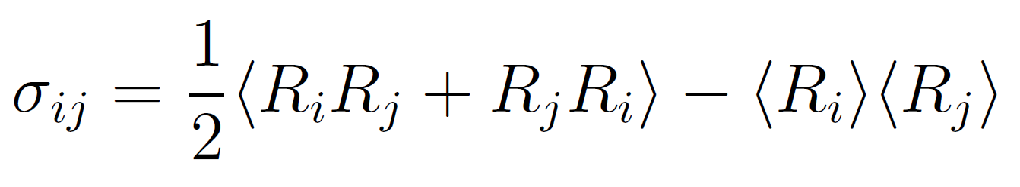
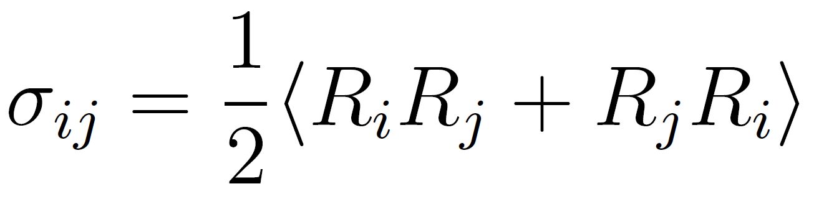
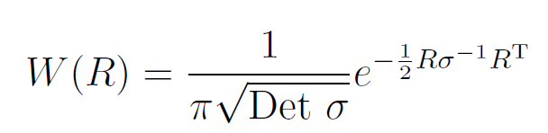
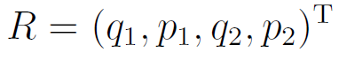
Covariance Matrix Formalism
Elements of a covariance matrix is defined as
Elements R_i denotes the i-th element of the vector containing the canonical variables. However, the expectation value of the first moments can be adjusted to zero using local unitary transformations. Thus the expression reduces to
Wigner function for a given covariance matrix is given by
For a two mode state,

Slide 19
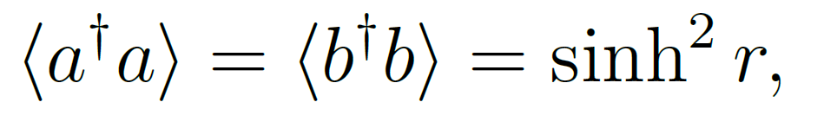
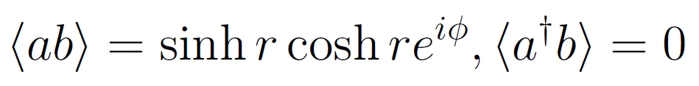
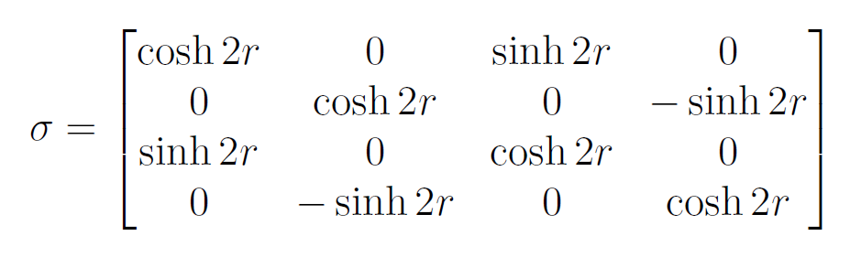
CM of Two mode Squeezed State
Matrix Elements of Two mode creation and annihilation operators
Covariance Matrix

Slide 20
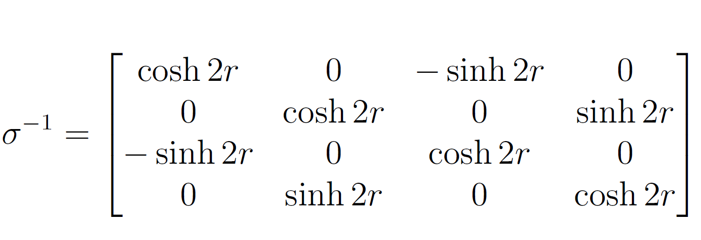
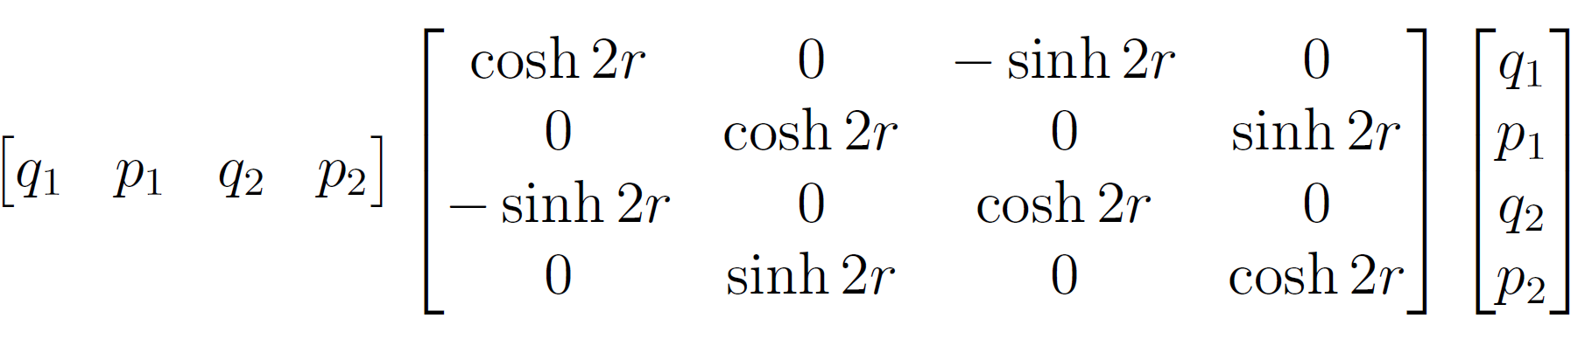
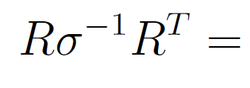
Wigner Function of Two mode Squeezed State
Wigner Function

Slide 21
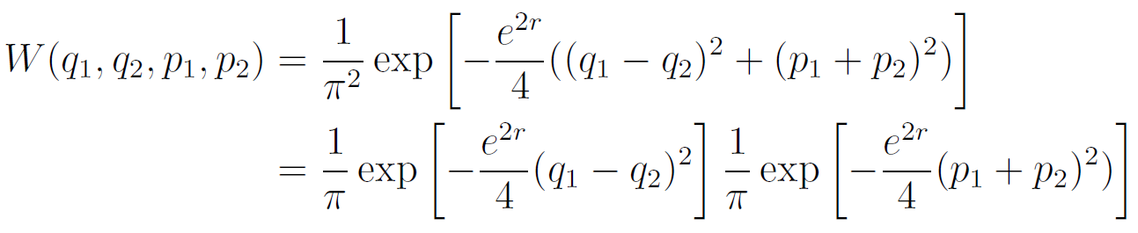
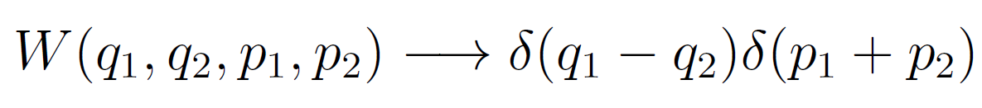
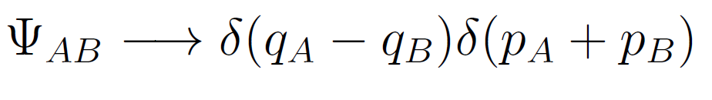
EPR State & Entanglement
As r is increased in the TMSS, (q1 + q2) and (p1 - p2) correlations in the wigner function becomes negligible.
The correlations contained in the state are between (q1 −q2) and (p1 + p2).
EPR State (Infinitely Entangled State)

Slide 22

Entanglement in TMSS
FIG : Density plot
Of TMSS in
q1-q2 and
p1+p2 space
with increasing
squeezing factor

Slide 23
Conclusion & Remarks
The Wigner function of quantum states are a key tool for their description in Phase Space. The other Phase Space distributions i.e. P-representation and Q-functions can also be
shown equivalent to Wigner description, however their applications are limited to only
few special cases.
Our derivation of Wigner representation of coherent and squeezed states and their photon
added versions can be really insightful for practical implications of these states.
The states are Gaussian states and hence minimum uncertainty states which distinguishes them in their applications. Their analysis using covariance matrix formalism can be extended to entanglement measures and finding negativity.
Wigner description is very much insightful in this analysis, the description may be extended to the entanglement in more number of modes.

Slide 24
References
[1] Gerardo Adesso, Fabrizio Illuminati: Entanglement in continuous-variable systems :
recent advances and current perspectives. Journal of Mathematical and Theoretical
Physics, 2007.
[2] G.S. Agarwal: Introductory Quantum Optics, 2nd edition, Cambridge University Press, 2012.
[3] Marlan O. Scully, M. Suhail Zubairy Quantum Optics 1st Edition, Cambridge University
Press,1997.
[4] Adesso G, Serafini A and Illuminati F 2006 Phys. Rev. A 73 032345.
[5] Alessio Serafini: Quantum Continuous Variables : A primer of theoretical methods,
CRC press, 2017.
[6] Matplotlib: comprehensive library for creating static, animated, and interactive
visualizations in Python, matplotlib.org

Slide 25
Acknowledgement
Dr. Tamoghna Das, Assistant Professor, Dept. Of Physics, IIT Kharagpur
Abhinash Kar, Research Scholar, Dept. Of Physics, IIT Kharagpur
Thank You
Project Report :
https://drive.google.com/file/d/1qZAXMu4X_LulngJ_mHZMoFYD0VoIdwq_/view

